Slide 1
Optimization of continuous-wave NIRS devices for placental monitoring. A simulation study
Charly Careddaª , Frédéric Lange^{b} , Niccole Ranaei-Zamani^{c} , Uzair Hakim^{b} ,
Olayinka Kowobari^{c} , Dimitrios Siassakos^{c} , Sara Hillman^{c} , Anna L David^{c} , Subhabrata Mitra^{c} and Ilias Tachtsidis^{b}
ª Univ Lyon, INSA‐Lyon, Université Claude Bernard Lyon 1, UJM-Saint Etienne, CNRS, Inserm, CREATIS UMR 5220, U1294, Lyon, France
^{b} Department of Medical Physics and Biomedical Engineering, University College London, London, UK
^{c} EGA Institute for Women’s Health, University College London, London, United Kingdom
June 25, 2025

Slide 2
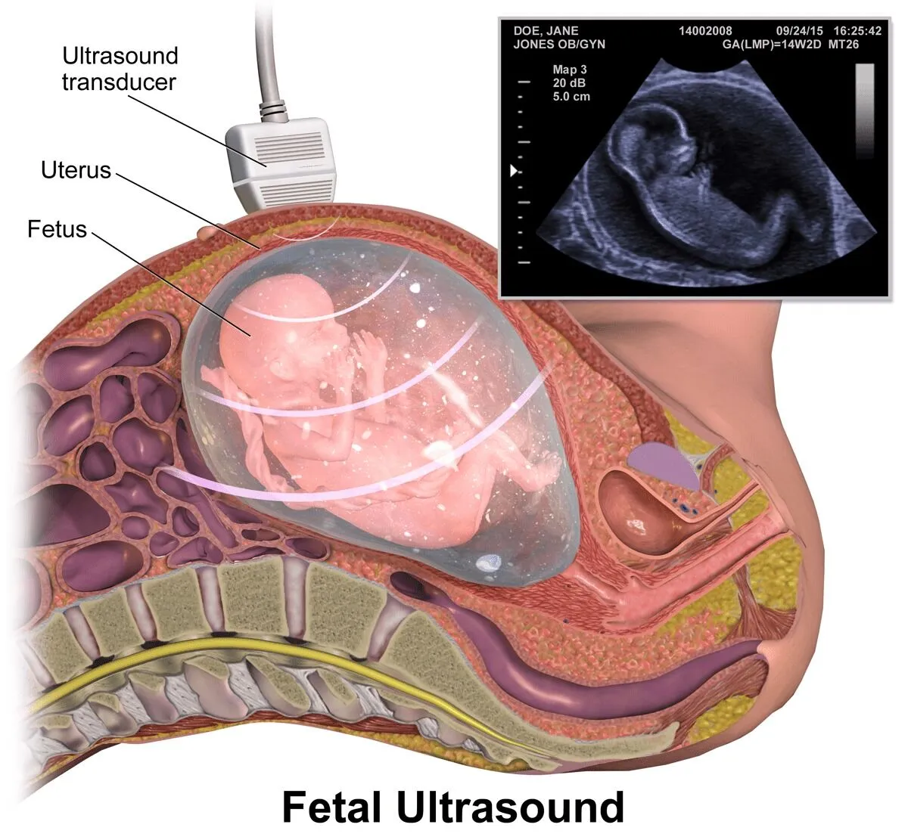
Placental function monitoring
Abnormal placenta development is a cause of adverse pregnancy outcomes [1]
Measuring placental oxygenation can be used to monitor the placental function
Clinical ultrasound devices do not include direct functional assessment of the placenta
MRI techniques are not suited for bedside monitoring
Fetal ultrasound exam [2]
1
[1] G. J. Burton et al. Physiol Rev. 2016 Oct;96(4):1509-65 [2] Image taken from https://www.abclawcenters.com/practice-areas/prenatal-birth-injuries/labor-and-delivery-complications-and-errors/placenta-previa/

Slide 3
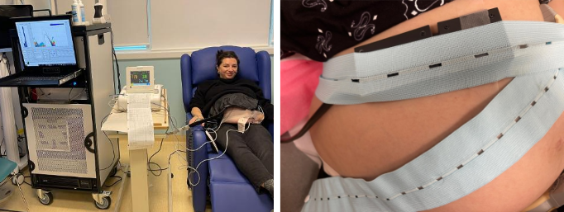

Problematic – Placenta sensitivity
What is the sensitivity of CW NIRS devices for monitoring placental function?
What is the best experimental configuration to monitor the placenta?
Maternal abdomen monitoring with in-house
developed broadband NIRS device at UCLH
Mini CYRIL [3]
In-house developed broadband NIRS device
3
4
5
<number>
Source detector separation (cm)
[3] Kaynezhad, P. et al., Neurophotonics 6(4), 045009–045009 (2019).

Slide 4
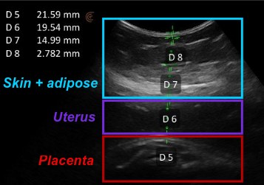
Problematic – Placenta sensitivity
What is the sensitivity of CW NIRS devices for monitoring placental function?
What is the best experimental configuration to monitor the placenta?
The measurement of placenta is not direct (skin, adipose tissue, muscle layers)
Mini CYRIL [3]
In-house developed broadband NIRS device
Ultrasound image of the maternal abdomen
collected by the clinical team at UCLH
3
4
5
Source detector separation (cm)
Emitted light source
Collected light for detectors at
3 cm
4 cm
Skin
Adipose tissue
Muscle
Placenta
<number>
[3] Kaynezhad, P. et al., Neurophotonics 6(4), 045009–045009 (2019).

Slide 5
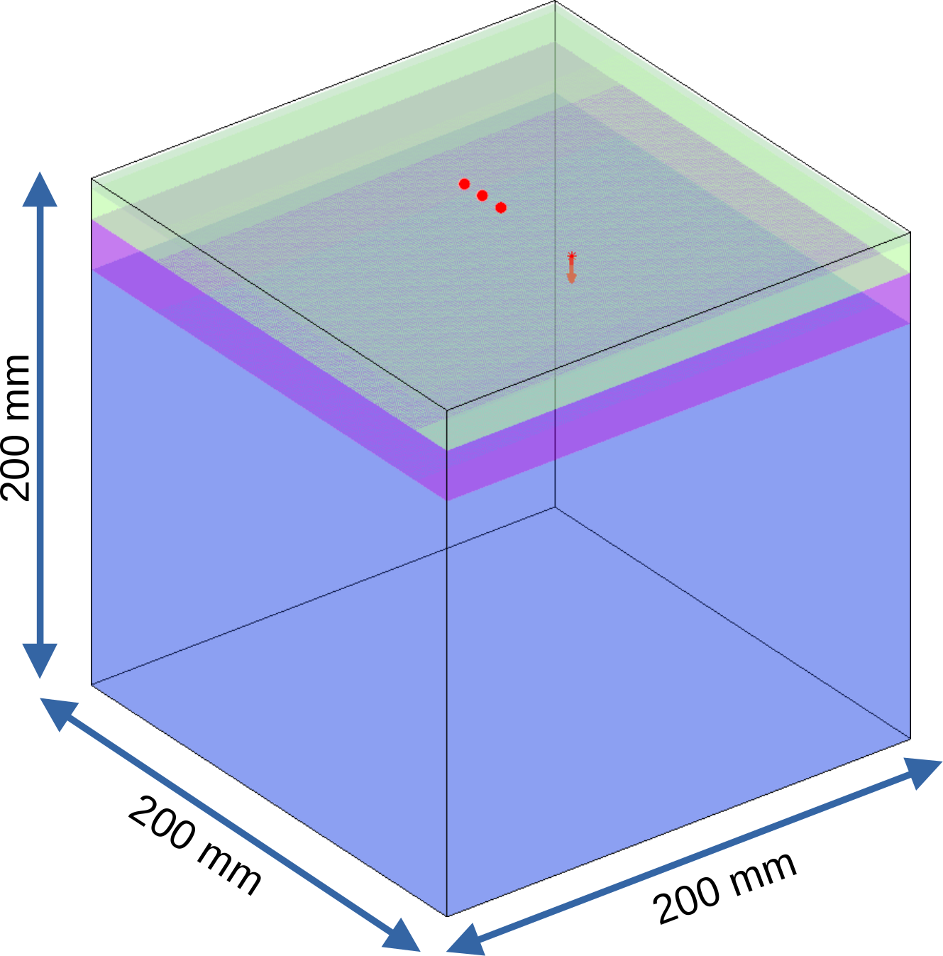
Placenta sensitivity – Monte Carlo simulations
Study the light propagation in the maternal abdomen with Monte Carlo simulations [4]
 | Skin | Adipose tissue | Muscle | Placenta
Thickness (mm) | [1, 2, 3, 4, 5] | [1, 2, 4, 8, 16] | [3, 7, 10, 13, 20, 25] | Semi-infinite
Melanin volume fraction (%) | [2.55, 15.5, 30.5] | - | - | -
Oxygen saturation (%) | 39 (dermis) | - | [40, 60, 80] | [40, 60, 80]
Blood volume (µM) | 4,7 (dermis) | - | [15, 25, 35, 50] | [15, 25, 35, 50]
Water volume fraction (%) | 0 | 80 | 76 | 85
Fat volume fraction (%) | 0 | 20 | 0 | 0
Scattering coefficient (cm⁻¹)
Refractive index n | 1.47 | 1.37 | 1.37 | 1.4
Anisotropy coefficient g | 0.83 | 0.9 | 0.9 | 0.9
Light source
10⁹ packets of photons
780 nm
One simulation per configuration
NVIDIA GeForce RTX 4080
51 840 simulations
Computation time ≈ 5 days (8 s per simulation)
Output
Diffuse reflectance (1.mm⁻².s⁻¹)
Fluence rate (1.mm⁻².s⁻¹)
Source detector
separation (cm)
5
4
3
<number>
Four layers Monte Carlo model
[4] Fang Q and Boas D (2009) Opt. Express, vol. 17, issue 22, pp. 20178-20190

Slide 6
Placenta sensitivity – Monte Carlo simulations
Study the light propagation in the maternal abdomen with Monte Carlo simulations [4]
 | Skin | Adipose tissue | Muscle | Placenta
Thickness (mm) | [1, 2, 3, 4, 5] | [1, 2, 4, 8, 16] | [3, 7, 10, 13, 20, 25] | Semi-infinite
Melanin volume fraction (%) | [2.55, 15.5, 30.5] | - | - | -
Oxygen saturation (%) | 39 (dermis) | - | [40, 60, 80] | [40, 60, 80]
Blood volume (µM) | 4,7 (dermis) | - | [15, 25, 35, 50] | [15, 25, 35, 50]
Water volume fraction (%) | 0 | 80 | 76 | 85
Fat volume fraction (%) | 0 | 20 | 0 | 0
Scattering coefficient (cm⁻¹)
Refractive index n | 1.47 | 1.37 | 1.37 | 1.4
Anisotropy coefficient g | 0.83 | 0.9 | 0.9 | 0.9
Light source
10⁹ packets of photons
780 nm
One simulation per configuration
NVIDIA GeForce RTX 4080
51 840 simulations
Computation time ≈ 5 days (8 s per simulation)
Output
Diffuse reflectance (1.mm⁻².s⁻¹)
Fluence rate (1.mm⁻².s⁻¹)
Source detector
separation (cm)
5
4
3
<number>
Four layers Monte Carlo model
[4] Fang Q and Boas D (2009) Opt. Express, vol. 17, issue 22, pp. 20178-20190

Slide 7
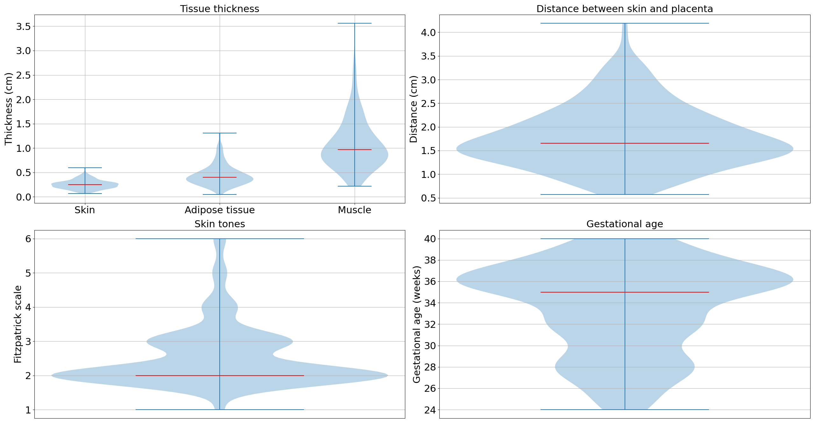
Clinical measurements
Tissue thickness with ultrasound images
Skin tones with Fitzpatrick scale [5]
Measurements performed at UCLH on 142 healthy participants
Tissue thickness, placenta depth and skin tone distributions
Ultrasound image of the maternal abdomen
collected by the clinical team at UCLH
Thickness percentiles (%) | Placenta depth (mm) | Skin thickness (mm) | Adipose tissue thickness (mm) | Muscle thickness (mm)
25 | 10 | 1 | 2 | 7
50 | 16 | 2 | 4 | 10
75 | 20 | 3 | 5 | 12
<number>
[5] Karsten, A. E. et al. (2012), Photochemistry and photobiology 88(2), 469–474 (2012).

Slide 8
Clinical measurements
Tissue thickness with ultrasound images
Skin tones with Fitzpatrick scale [5]
Measurements performed at UCLH on 142 healthy participants
Tissue thickness, placenta depth and skin tone distributions
Ultrasound image of the maternal abdomen
collected by the clinical team at UCLH
Thickness percentiles (%) | Placenta depth (mm) | Skin thickness (mm) | Adipose tissue thickness (mm) | Muscle thickness (mm)
25 | 10 | 1 | 2 | 7
50 | 16 | 2 | 4 | 10
75 | 20 | 3 | 5 | 12
<number>
[5] Karsten, A. E. et al. (2012), Photochemistry and photobiology 88(2), 469–474 (2012).

Slide 9
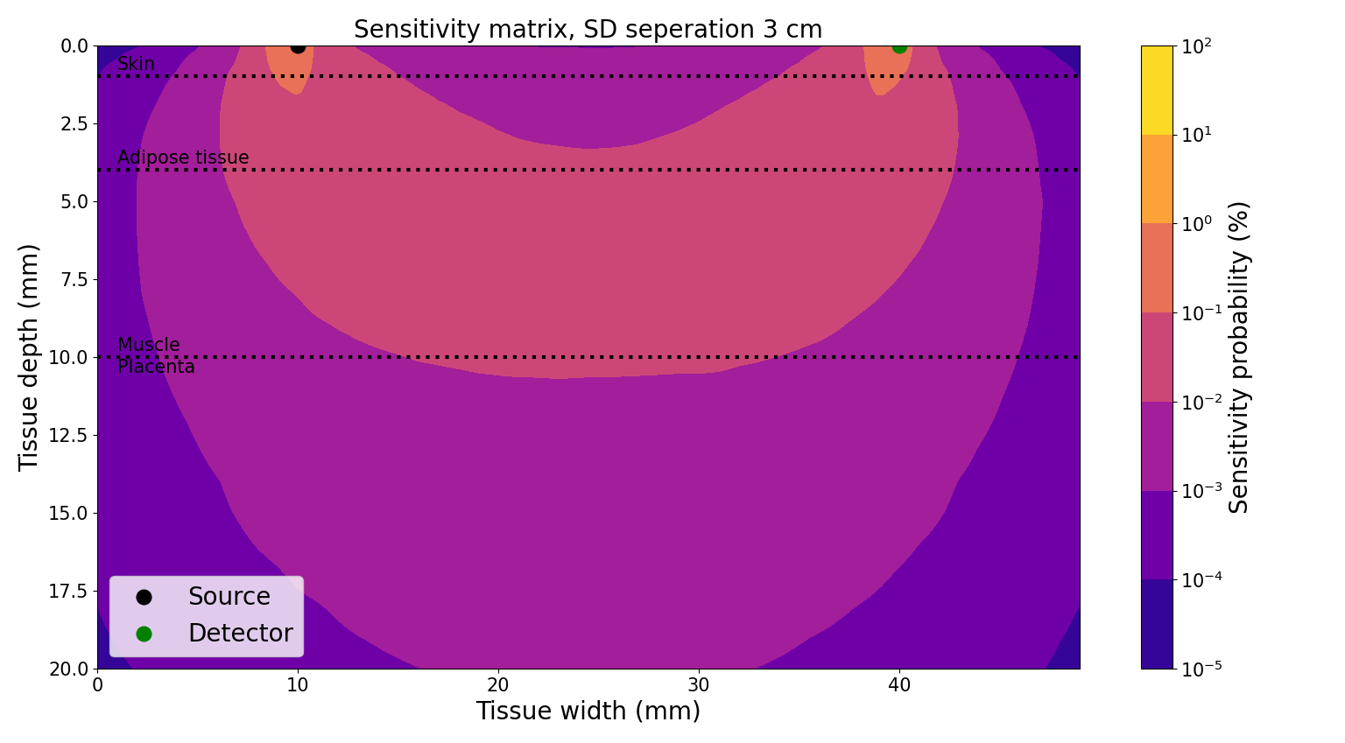
Placenta sensitivity
Probability that the detected light at detector D has passed through the placenta
Calculation of the sensitivity profile with the adjoint method [6]:
Voxel-wise multiplication between FS et FD (Fluence rate for source at position S and D)
Normalization of the sensitivity profile by its sum (probability density P)
<number>
[6] Yao, R et al. Biomedical optics express 9(10), 4588–4603 (2018)

Slide 10
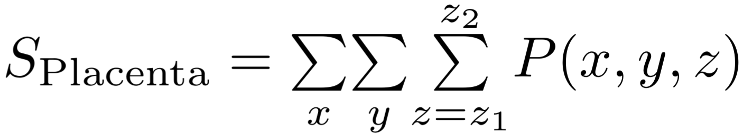
Placenta sensitivity
Probability that the detected light at detector D has passed through the placenta
Emitted light source S
Collected light for detectors at
D cm
J cm
Skin
Adipose tissue
Muscle
z1
Placenta
z2
z
Placenta sensitivity
<number>

Slide 11
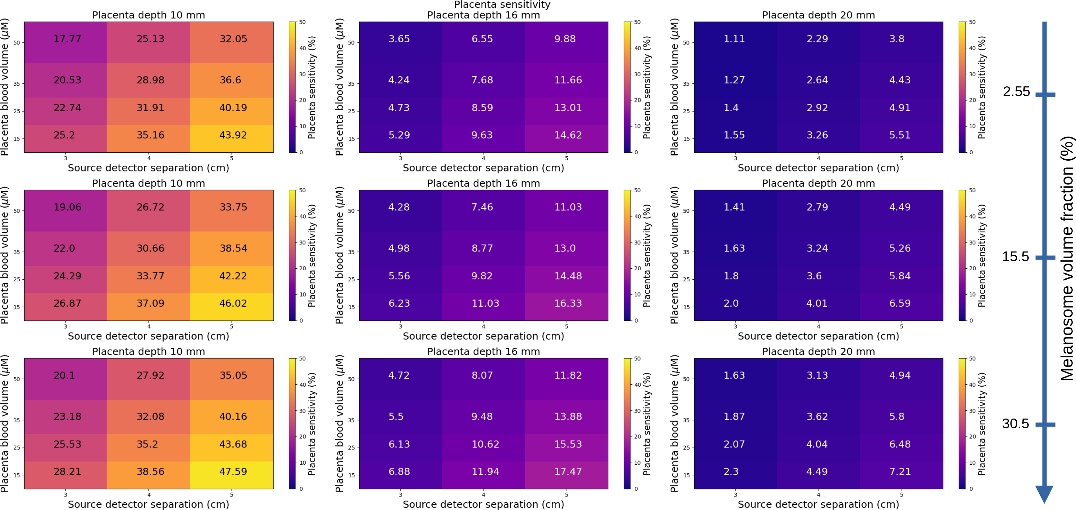
Placenta sensitivity versus blood volume and SD-separation
Probability that the light has passed through the placenta
Thickness percentiles (%) | Placenta depth (mm) | Skin thickness (mm) | Adipose tissue thickness (mm) | Muscle thickness (mm)
25 | 10 | 1 | 2 | 7
Muscle blood volume: 25 µMol
Muscle SatO2 = 60% Placenta SatO2 = 80%
<number>

Slide 12
Placenta sensitivity versus blood volume and SD-separation
Probability that the light has passed through the placenta
Placental sensitivity decreases with increasing placental blood volume
Thickness percentiles (%) | Placenta depth (mm) | Skin thickness (mm) | Adipose tissue thickness (mm) | Muscle thickness (mm)
25 | 10 | 1 | 2 | 7
Muscle blood volume: 25 µMol
Muscle SatO2 = 60% Placenta SatO2 = 80%
<number>

Slide 13
Placenta sensitivity versus blood volume and SD-separation
Probability that the light has passed through the placenta
Placental sensitivity increases with increasing source-detector separation
Thickness percentiles (%) | Placenta depth (mm) | Skin thickness (mm) | Adipose tissue thickness (mm) | Muscle thickness (mm)
25 | 10 | 1 | 2 | 7
Muscle blood volume: 25 µMol
Muscle SatO2 = 60% Placenta SatO2 = 80%
<number>

Slide 14
Placenta sensitivity versus placenta depth
Placenta depth: 10 mm
Placenta depth: 10 mm
Placenta depth: 16 mm
Placental sensitivity decreases with increasing placenta depth
Placenta depth: 20 mm
Thickness percentiles (%) | Placenta depth (mm) | Skin thickness (mm) | Adipose tissue thickness (mm) | Muscle thickness (mm)
25 | 10 | 1 | 2 | 7
50 | 16 | 2 | 4 | 10
75 | 20 | 3 | 5 | 12
Muscle blood volume: 25 µMol
Muscle SatO2 = 60% Placenta SatO2 = 80%
<number>

Slide 15
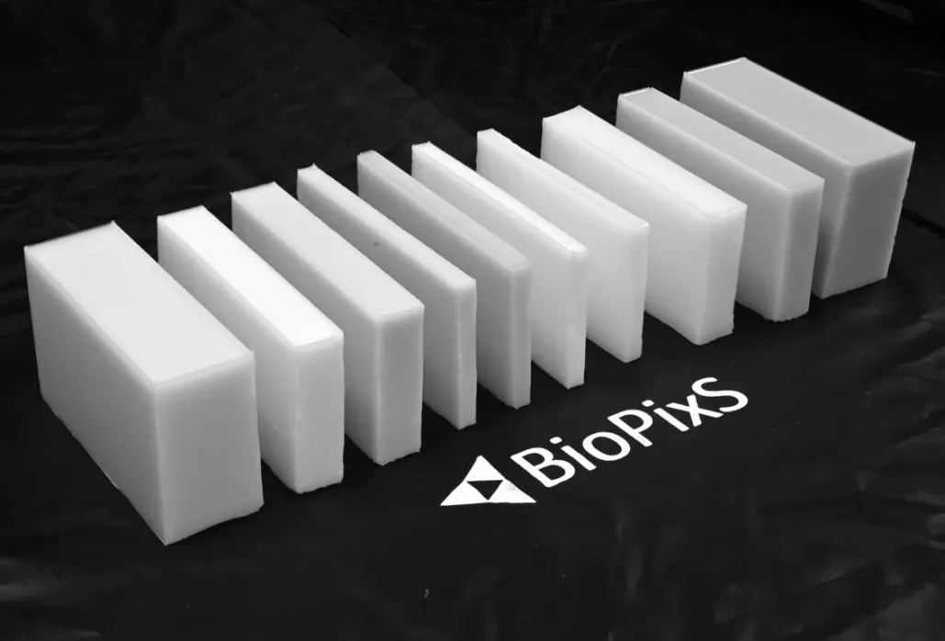
Phantom calibration procedure
Solid phantom measurements with Mini CYRIL [3]
Monte carlo simulations of the solid phantom
In-house developed broadband NIRS device
Emitted light source
3 cm
4 cm
5 cm
0
Source-detector
separation (cm)
µa=0.05 cm⁻¹, µs = 9.3 cm⁻¹, n = 1.37, g = 0.9
4
µa=0.98 cm⁻¹, µs = 12 cm⁻¹, n = 1.37, g = 0.9
6
µa=0.11 cm⁻¹, µs = 8 cm⁻¹, n = 1.37, g = 0.9
9
109
µa=0.1 cm⁻¹, µs = 10 cm⁻¹, n = 1.37, g = 0.9
Scale measurements to MC data
Thickness (mm)
Calculate minimum detectable signal
in MC data
Calculate probability of MC data to be above measurement noise level
<number>
[3] Kaynezhad, P. et al., Neurophotonics 6(4), 045009–045009 (2019).

Slide 16
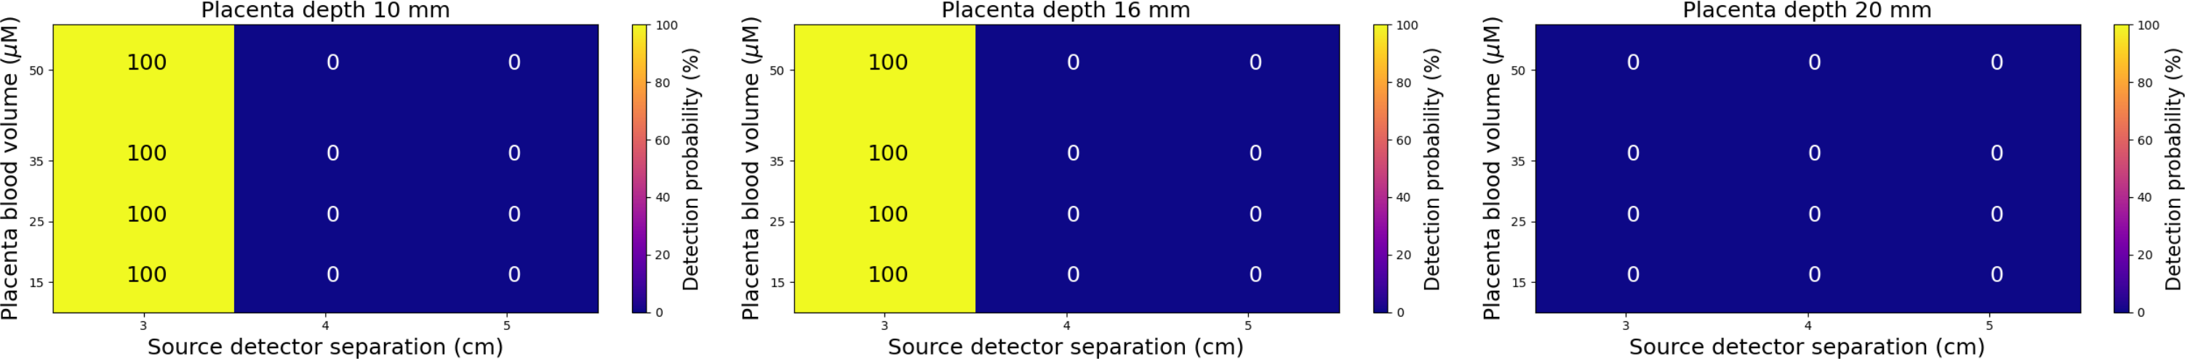
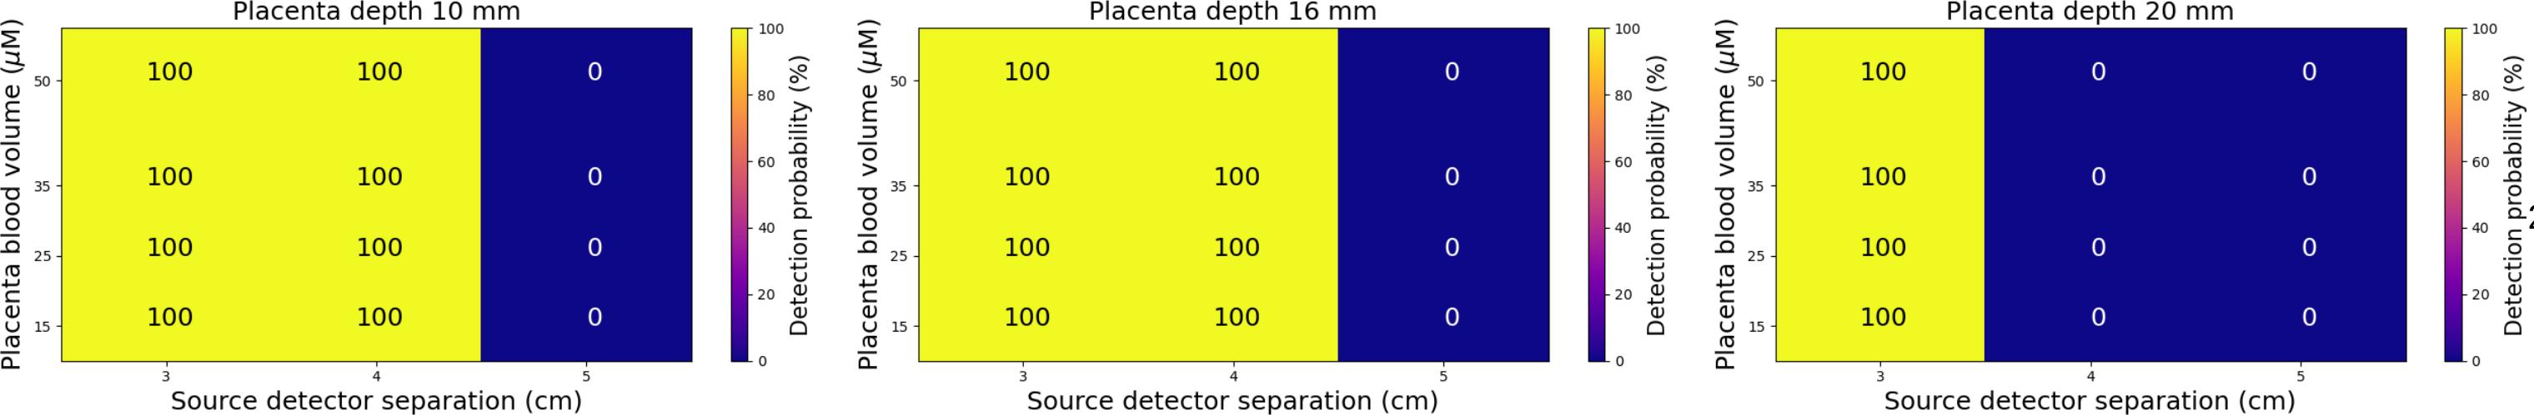
Probability of acquiring a signal above the noise level
Integration time 1 s
Placenta depth: 10 mm
Placenta depth: 16 mm
Placenta depth: 20 mm
Integration time 1 s - temporal binning 10 s
Placenta depth: 10 mm
Placenta depth: 16 mm
Placenta depth: 20 mm
Detection probability increasing with increasing temporal binning
Thickness percentiles (%) | Placenta depth (mm) | Skin thickness (mm) | Adipose tissue thickness (mm) | Muscle thickness (mm)
25 | 10 | 1 | 2 | 7
50 | 16 | 2 | 4 | 10
75 | 20 | 3 | 5 | 12
Muscle blood volume: 25 µMol
Muscle SatO2 = 60% Placenta SatO2 = 80%
<number>

Slide 17
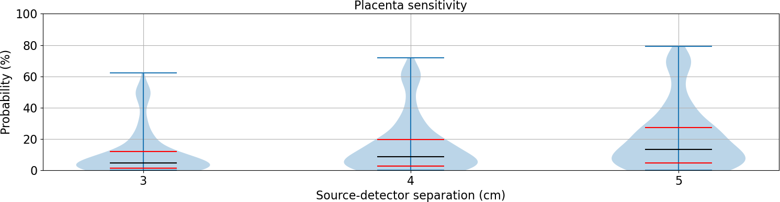
Placenta Sensitivity calculated for 142 participants
Probability that the light has passed through the placenta
Distribution of probabilities calculated for 142 participants
9 %
13.4 %
5.3 %
Placental sensitivity increases with increasing source-detector separation
<number>
<number>

Slide 18
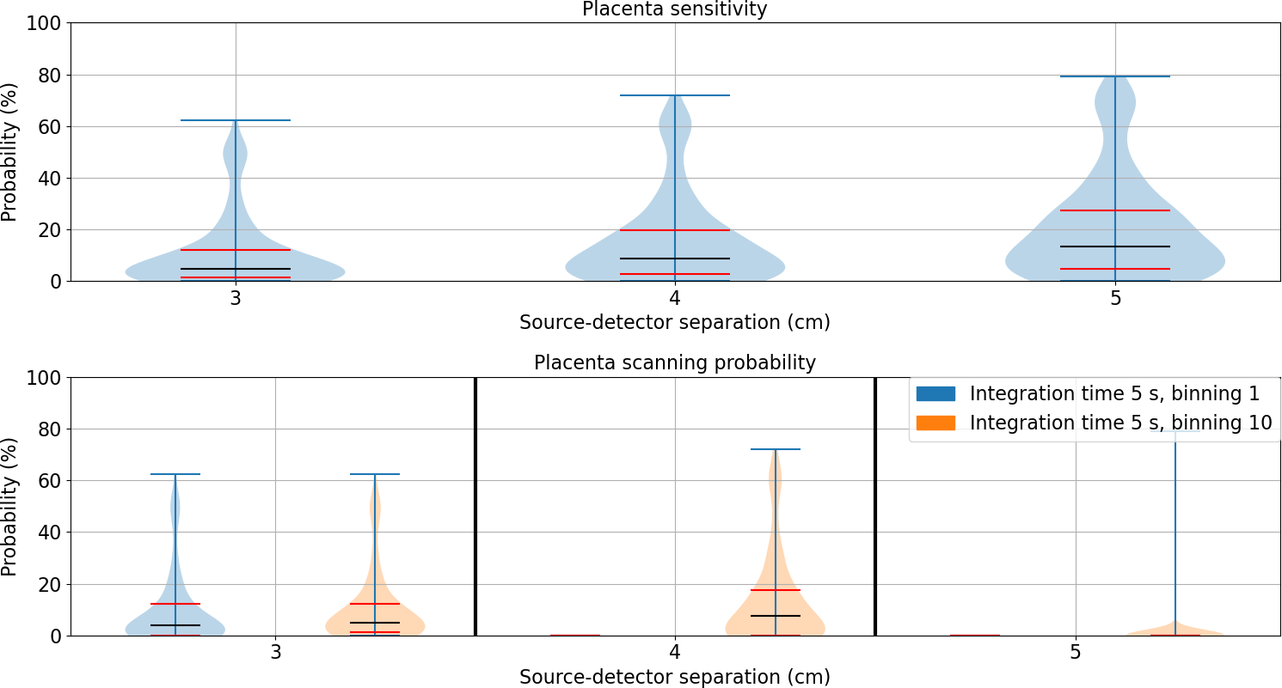
Placenta Scanning probability calculated for 142 participants
Probability of acquiring a signal above the noise level and that the light has passed through the placenta - Distribution of probabilities calculated for 142 participants
9 %
13.4 %
5.3 %
4.2 %
5 %
0 %
7.6 %
0 %
0 %
Placental scanning probability increases with increasing temporal binning
<number>
<number>

Slide 19
Discussion and Conclusion
Monte Carlo framework optimises NIRS acquisition parameters for placental monitoring
Ultrasound imaging is necessary before NIRS acquisition to evaluate placenta depth
CW-NIRS devices are more effective for placentas closer to the surface
Placenta sensitivity is ≤ 7 % for a 2 cm placenta depth
Placenta sensitivity is 39 % for a 1 cm placenta depth using 5 cm source-detector separation
Acquisition parameters have a major impact on placenta sensitivity
Placenta sensitivity could be enhanced with an optimized device: LED-based multi-wavelength NIRS system
Future works
Evaluate placental function with the measurement of placental tissue oxygenation
<number>

Slide 20
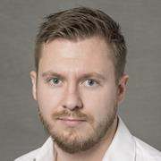
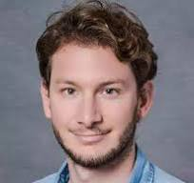

Thank you for your attention
W1B.5 Frederic Lange et al. Optimizing deep tissue monitoring with diffuse optics: virtual tools for TD-NIRS and TD-SCOS development
W2B.1 Luca Giannoni et al. Standardised testing procedure based on optical phantoms for validation of photonics instrumentation aimed at clinical monitoring of the placenta
Tu2A.23 Uzair Hakim et al. Optimising Placenta Oxygenation Estimation: A Monte Carlo Simulation Study

Slide 21
Placenta sensitivity versus melanosome volume fraction
Melanosome vol. fraction: 2.55 %
Melanosome vol. fraction: 15.5 %
Placenta depth: 10 mm
Placental sensitivity increases with increasing melanosome volume fraction
Melanosome vol. Fraction: 30.5 %
Thickness percentiles (%) | Placenta depth (mm) | Skin thickness (mm) | Adipose tissue thickness (mm) | Muscle thickness (mm)
25 | 10 | 1 | 2 | 7
Muscle blood volume: 25 µMol
Muscle SatO2 = 60% Placenta SatO2 = 80%
<number>

Slide 22
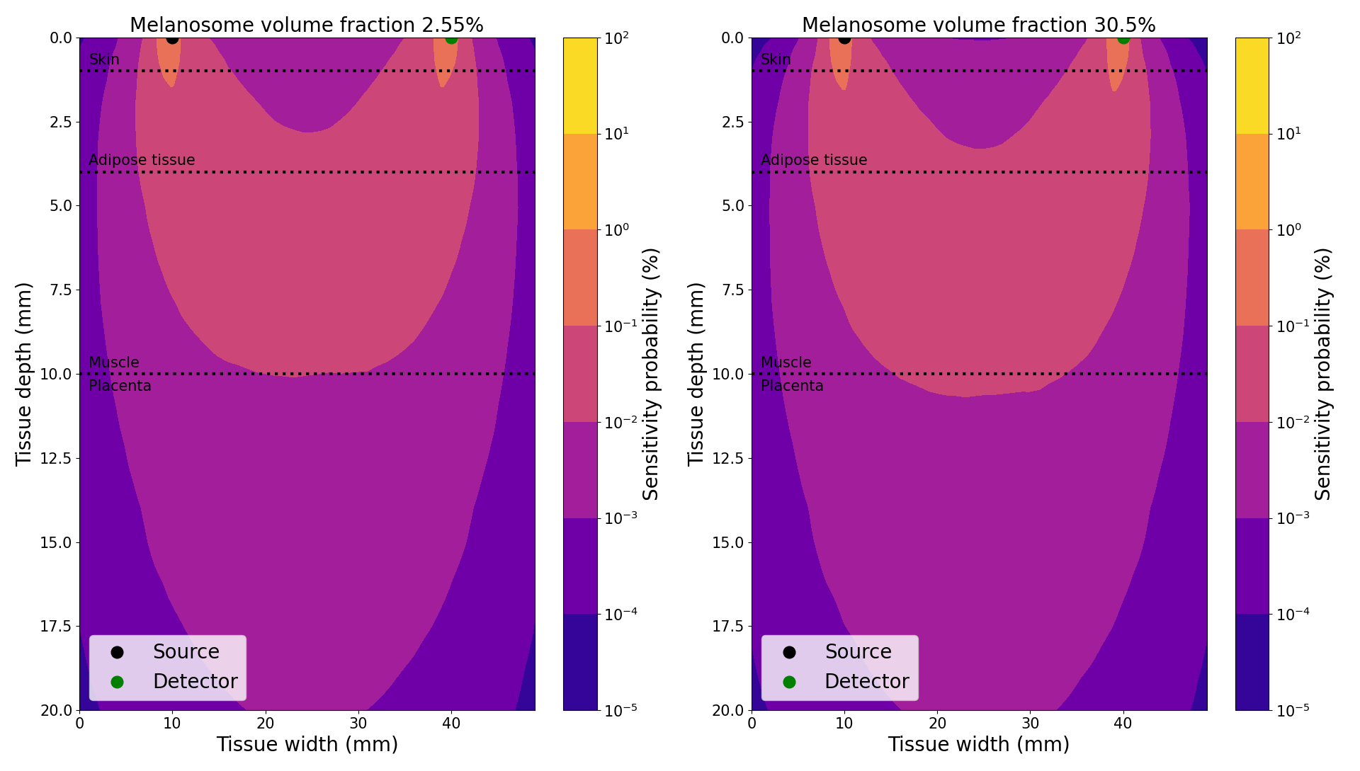
Placenta sensitivity – Melanin effect
Probability that the light has passed through the placenta
<number>
Further investigation is needed!

Slide 23
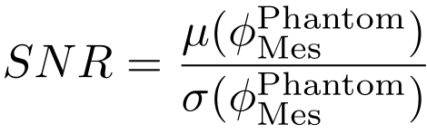
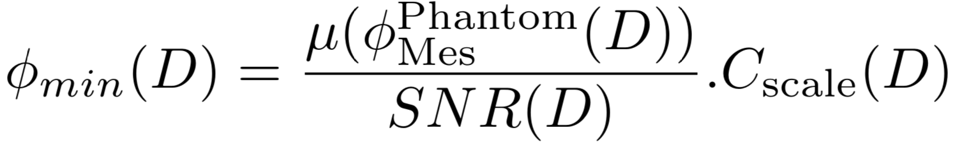
Detection probability – Phantom calibration procedure
Probability that the signal collected by a real device is above the noise level
1) Perform measurements Mes of the multi-layered phantom with a CW NIRS device (Mini CYRIL [2])
- Source-detector separation (3 cm, 4 cm, 5 cm)
- Several integration time (1 s, 5 s, 10 s)
2) Perform MC simulations MC of the multi-layered phantom (1000 points)
3) Calculate measurement Signal to Noise Ratio:
4) Scale Measurements to MC data:
5) Calculate minimum detectable diffuse reflectance value:
<number>
[2] Kaynezhad, P. et al., Neurophotonics 6(4), 045009–045009 (2019).

Slide 24
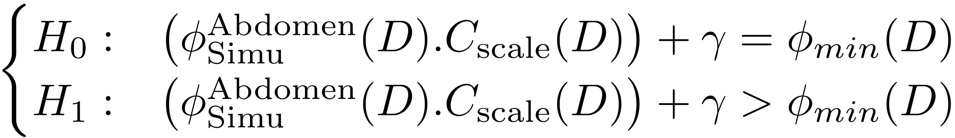
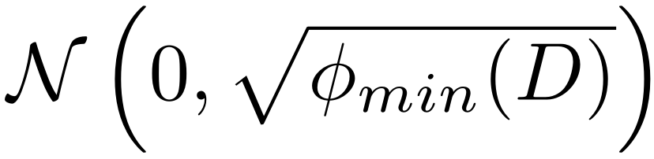
Detection probability – Phantom calibration procedure
Detection Probability
Probability that the signal collected is above the noise level (minimum detectable diffuse reflectance)
Detection probability PD (one-sided T-Test):
With γ a vector a 1000 elements representing the sensor noise, having a Normal distribution
<number>

Slide 25
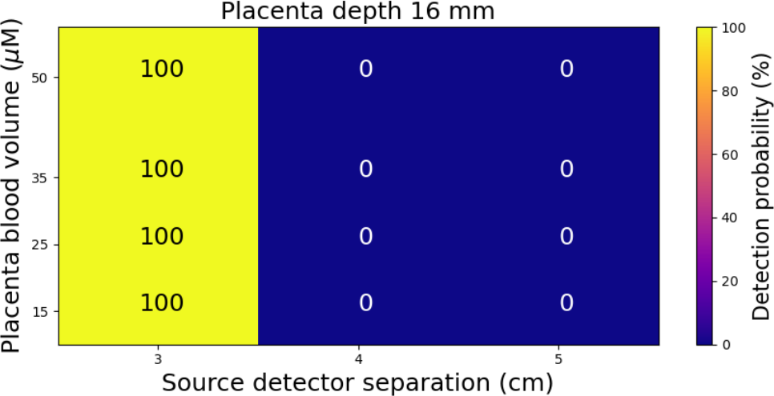
Probability of acquiring a signal above the noise level
Integration time 1 s
Detection probability decreases with increasing source-detector separation
Thickness percentiles (%) | Placenta depth (mm) | Skin thickness (mm) | Adipose tissue thickness (mm) | Muscle thickness (mm)
50 | 16 | 2 | 4 | 10
Muscle blood volume: 25 µMol
Muscle SatO2 = 60% Placenta SatO2 = 80%
<number>

Slide 26
Probability of acquiring a signal above the noise level
Integration time 1 s
Placenta depth: 10 mm
Placenta depth: 16 mm
Detection probability decreases with increasing placenta depth
Placenta depth: 20 mm
Thickness percentiles (%) | Placenta depth (mm) | Skin thickness (mm) | Adipose tissue thickness (mm) | Muscle thickness (mm)
25 | 10 | 1 | 2 | 7
50 | 16 | 2 | 4 | 10
75 | 20 | 3 | 5 | 12
Muscle blood volume: 25 µMol
Muscle SatO2 = 60% Placenta SatO2 = 80%
<number>

Slide 27
Probability of acquiring a signal above the noise level
Integration time 1 s
Melanosome vol. fraction: 2.55 %
Melanosome vol. fraction: 15.5 %
Detection probability decreases with increasing melanosome volume fraction
Melanosome vol. fraction: 30.5 %
Thickness percentiles (%) | Placenta depth (mm) | Skin thickness (mm) | Adipose tissue thickness (mm) | Muscle thickness (mm)
50 | 16 | 2 | 4 | 10
Muscle blood volume: 25 µMol
Muscle SatO2 = 60% Placenta SatO2 = 80%
<number>

Slide 28
Placenta sensitivity
Probability that the light has passed through the placenta
Thickness percentiles (%) | Placenta depth (mm) | Skin thickness (mm) | Adipose tissue thickness (mm) | Muscle thickness (mm)
25 | 10 | 1 | 2 | 7
50 | 16 | 2 | 4 | 10
75 | 20 | 3 | 5 | 12
Muscle blood volume: 25 µMol
Muscle SatO2 = 60% Placenta SatO2 = 80%
<number>

Slide 29
Detection probability – Phantom calibration procedure
Probability that the signal collected by a real device is above the noise level
1) Perform measurements Mes of the multi-layered phantom with a CW NIRS device (Mini CYRIL [2])
- Source-detector separation (3 cm, 4 cm, 5 cm)
- Several integration time (1 s, 5 s, 10 s)
2) Perform MC simulations MC of the multi-layered phantom (1000 points)
Emitted light source
3 cm
4 cm
5 cm
0
Source-detector
separation (cm)
µa=0.05 cm⁻¹, µs = 9.3 cm⁻¹, n = 1.37, g = 0.9
4
µa=0.98 cm⁻¹, µs = 12 cm⁻¹, n = 1.37, g = 0.9
6
µa=0.11 cm⁻¹, µs = 8 cm⁻¹, n = 1.37, g = 0.9
9
109
µa=0.1 cm⁻¹, µs = 10 cm⁻¹, n = 1.37, g = 0.9
Thickness (mm)
<number>
[2] Kaynezhad, P. et al., Neurophotonics 6(4), 045009–045009 (2019).

Slide 30
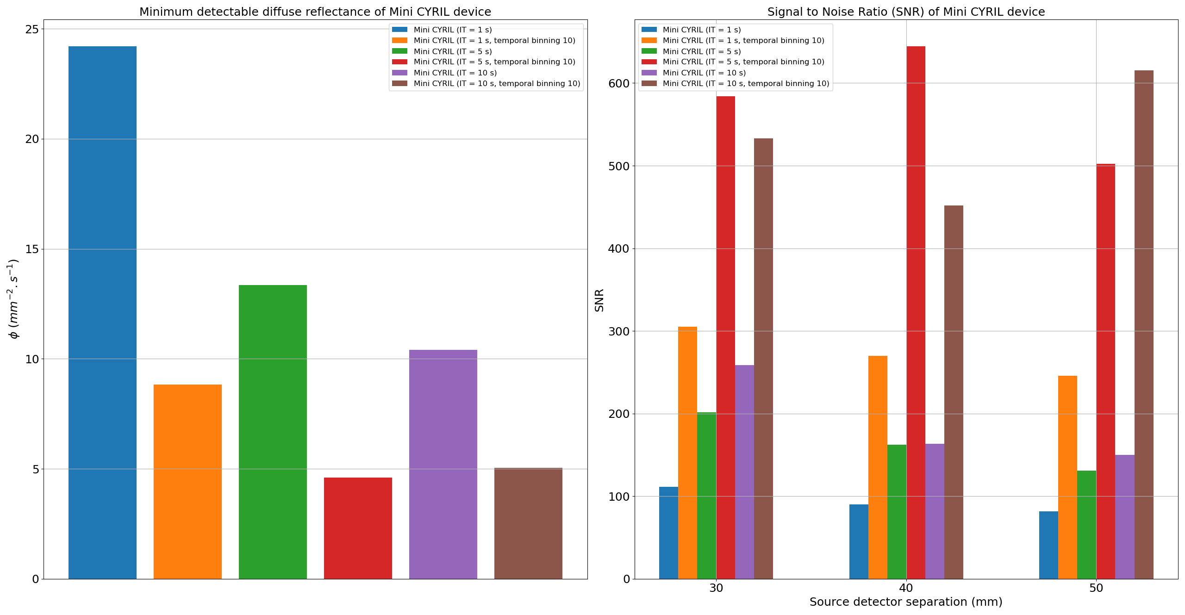
Detection probability – Phantom calibration procedure
<number>

Slide 31
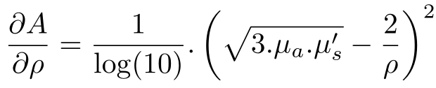
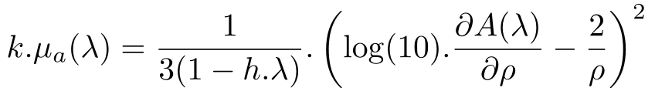
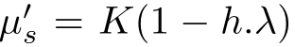
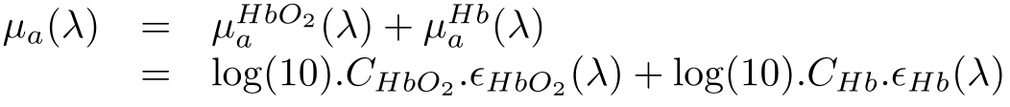
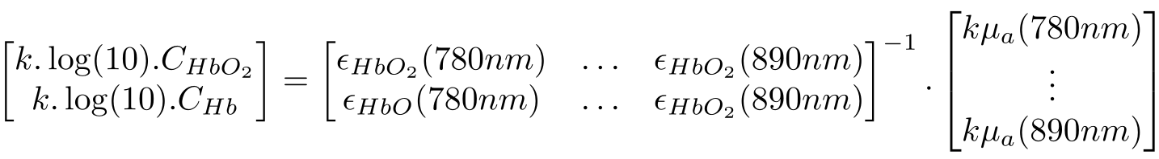
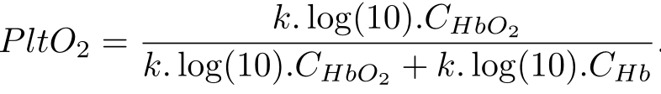
Placental tissue oxygenation estimation
Estimation with standard spatially resolved spectroscopy algorithm (SRS) [7]
Hypothesis: homogeneous tissue
Simulated data (multi-distance broadband spectrum 780 nm to 890 nm)
with
µa is mainly due to Hb and HbO2 contributions:
Placental tissue oxygenation
<number>
[7] Suzuki, S. Et al. in [Optical tomography and spectroscopy of tissue III ], 3597, 582–592, SPIE (1999)

Slide 32
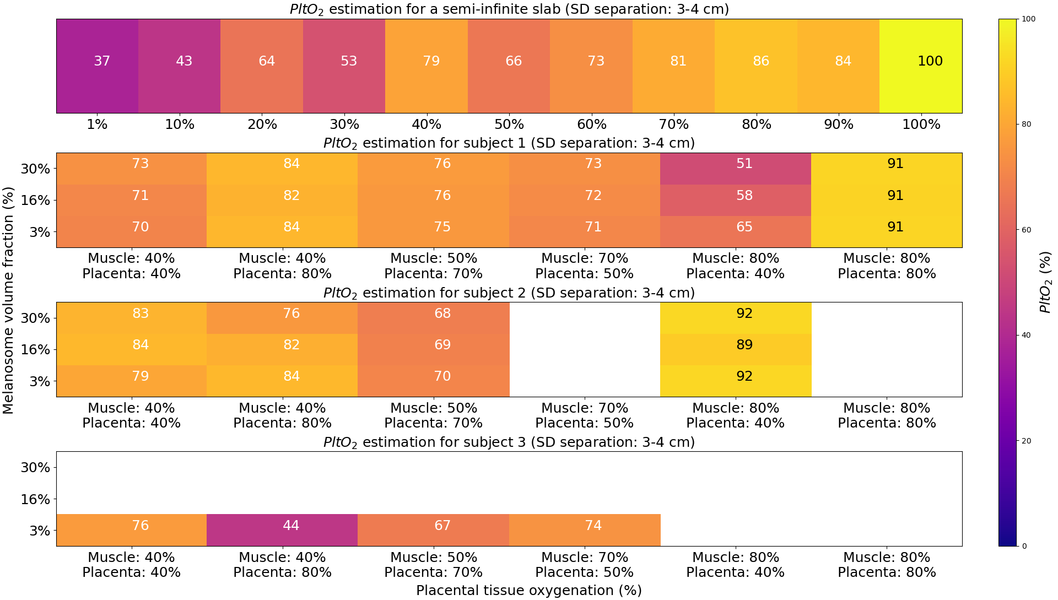
Placental tissue oxygenation estimation
Subject ID | Thickness percentiles (%) | Placenta depth (mm) | Skin thickness (mm) | Adipose tissue thickness (mm) | Muscle thickness (mm)
1 | 25 | 10 | 1 | 2 | 7
2 | 50 | 16 | 2 | 4 | 10
3 | 75 | 20 | 3 | 5 | 12
<number>

Slide 33
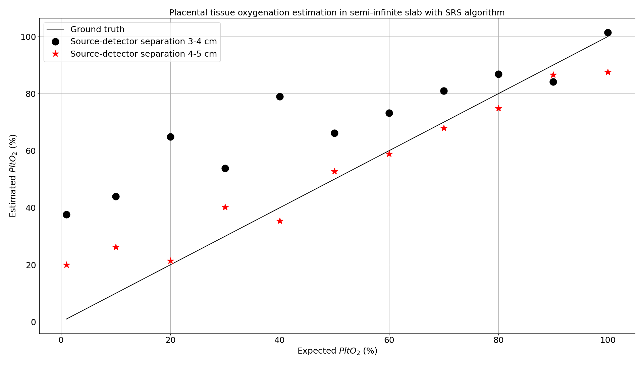
Placental tissue oxygenation estimation
<number>

